Slide 1



Uncover Hidden Patterns In Your Tabular Datasets: All You Need Is The Right Statistics
Tabular datasets can be challenging and time-consuming to analyze. However, with the right techniques and tools, you can get the most out of minimal effort.
Podcast included

Slide 2
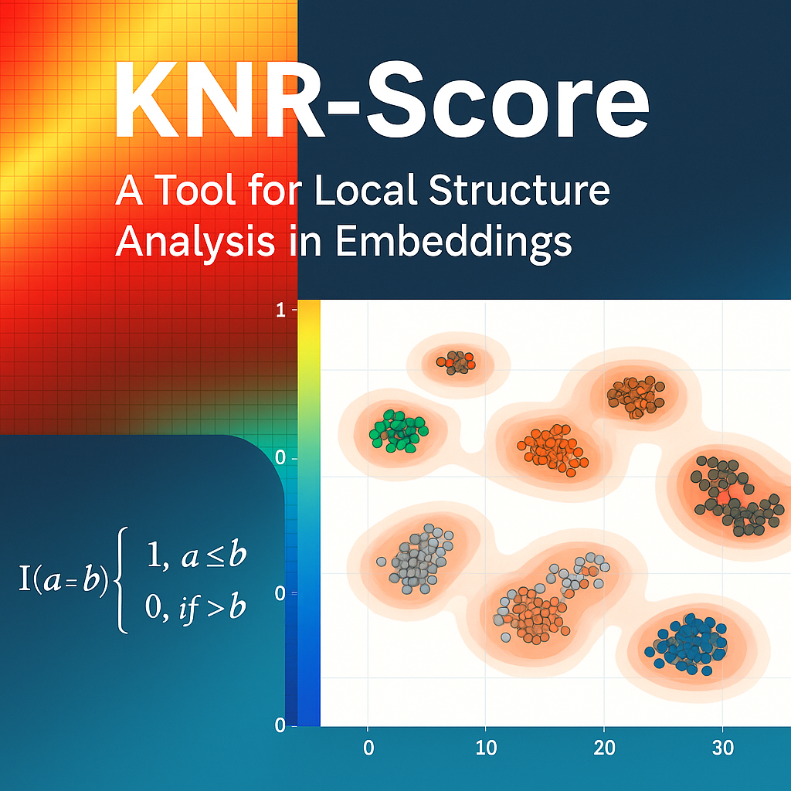
K-Nearest-Rank Scores: A Tool for Local Structure Analysis in Embeddings
When using a low-dimensional projection, we should always be aware that it is merely a projection of a higher and more complex dimensional space. To truly trust these projections, we need to assess how well they preserve the original sample distribution.
Podcast included

